Slide 1

Microsoft PowerPoint
LECTURE 3

Slide 2
Introduction to Microsoft PowerPoint and
Tips for Effective Presentation

Slide 3


Tips for better presentation
Planning
Preparation
Practice
Performance
Questions

Slide 4
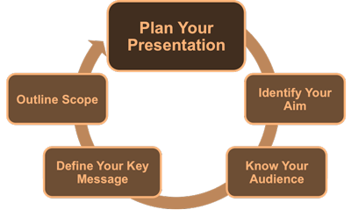
Planning
Understand the audience
Decide the topic
Inform the participants
Study and Master the contents
Decide the contents to cover
Outline the presentation
Arrange all the material / tools

Slide 5

Preparation
Prepare slides
Proof read
Prepare notes
  brief keywords and phrases, except maybe first couple of paragraphs.

Slide 6
Slides Structure
Title Slide (1) Title, author, affiliation, acknowledgements
Rationale (1-2) Why this is interesting / objectives
Outline (1-2) What is covered
Contents (3...) The details
Summary (1) Key points to remember
Q/A

Slide 7
Slides - Outline
Make your 1st or 2nd slide an outline of your presentation
Follow the order of your outline for the rest of the presentation
Only place main points on the outline slide
Ex: Use the titles of each slide as main points

Slide 8
Preparation of Slides – GOOD
Use 1-2 slides per minute of your presentation
Write in point form, not complete sentences
Include 4-5 points per slide
Avoid wordiness: use key words and phrases only

Slide 9
Preparation of Slides– Is this good?
This page contains too many words for a presentation slide. It is not written in point form, making it difficult both for your audience to read and for you to present each point. Although there are exactly the same number of points on this slide as the previous slide, it looks much more complicated. In short, your audience will spend too much time trying to read this paragraph instead of listening to you.

Slide 10
Preparation of Slides– this is better
Show one point at a time:
  Will help audience concentrate on what you are saying
  Will prevent audience from reading ahead
  Will help you keep your presentation focused

Slide 11
Preparation of Slides - BAD
Overboard with the animation
Inconsistent with the animation that you use
Using distracting animation

Slide 12
Fonts - GOOD
Use appropriate font style and size.
Use different size fonts for main points and
  secondary points.
Use a standard font like Times New Roman or Arial.

Slide 13
Fonts - BAD
If you use a small font, your audience won’t be able to read what you have written
CAPITALIZE ONLY WHEN NECESSARY. IT IS DIFFICULT TO READ.
Don’t use a complicated font

Slide 14
Colour - GOOD
Use a color of font that contrasts sharply with the background.
  Ex: blue font on white background
Use color to reinforce the logic of your structure.
  Ex: light blue title and dark blue text
Use color to emphasize a point.
  But only use this occasionally

Slide 15
Colour - BAD
Using a font colour that does not contrast with the background colour is hard to read.
Using colour for decoration is distracting and annoying.
Using a different colour for each point is unnecessary.
Using a different colour for secondary points is also unnecessary.
Trying to be creative can also be bad.

Slide 16
Background - GOOD
Use backgrounds such as this one that are attractive but simple.
Use backgrounds which are light.
Use the same background consistently throughout your presentation.

Slide 17
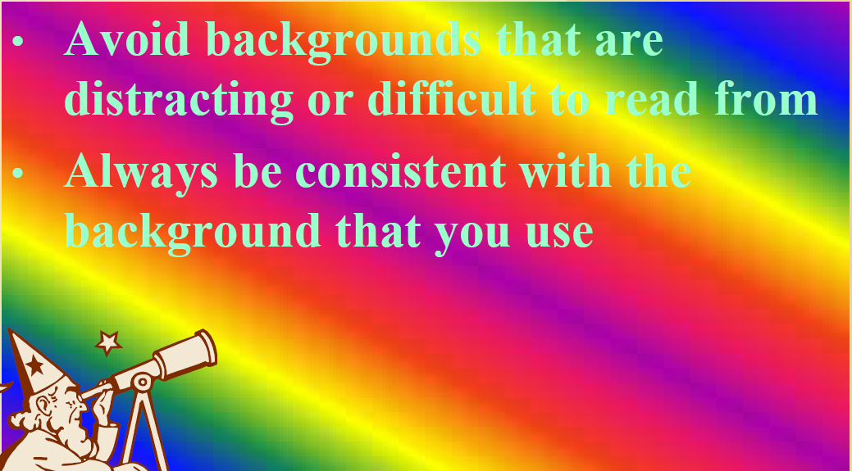
Background – BAD

Slide 18
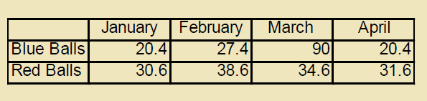
Tables - BAD

Slide 19
Graphs - GOOD
Use graphs rather than just charts and words;
  Data in graphs is easier to comprehend & retain than is raw data,
  Trends are easier to visualize in graph form.
Always title your graphs.

Slide 20
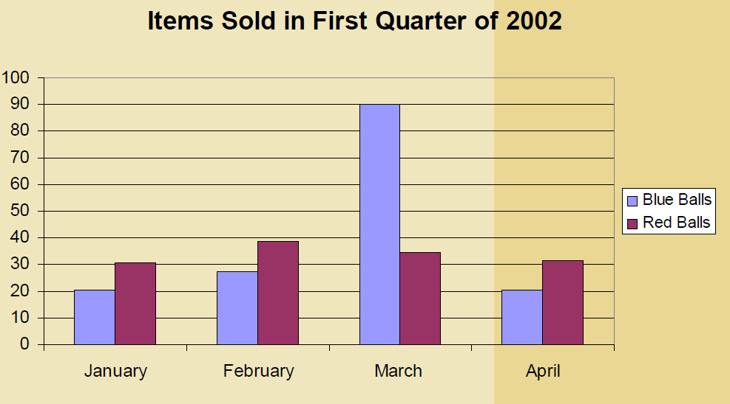
Graphs - GOOD

Slide 21
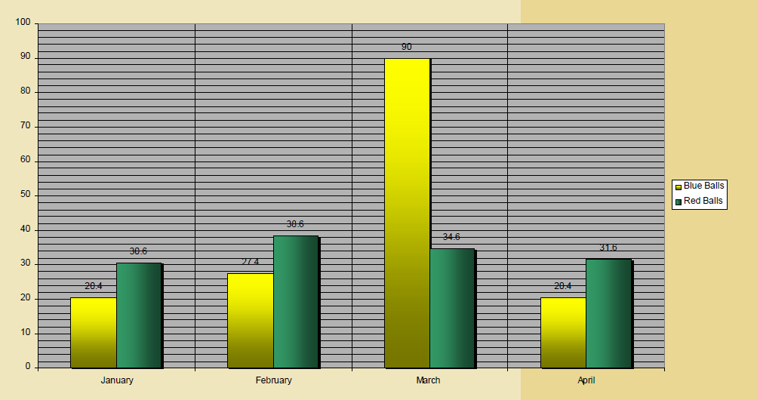
Graphs - BAD

Slide 22
Graphs - BAD
Minor gridlines are unnecessary
Font is too small
Colours are illogical
Title is missing
Shading is distracting

Slide 23
Spelling and Grammar
Proof read your slides for:
  speling mistakes
  the use of of repeated words
  grammatical errors you might have make
If English is not your first language, please have someone else check your presentation!

Slide 24
Slide - Conclusion
Use an effective and strong closing.
Your audience is likely to remember your last words.
Use a conclusion slide to:
  Summarize the main points of your presentation,
  Suggest future avenues of research / reading.

Slide 25
Practice
Practice, practice,
practice!
Get feedback, and use it.
Be ruthless - delete unnecessary information

Slide 26
PERFORMANCE

Slide 27

Presentation – Podium panic
For some people, the thought of giving a presentation is more frightening than
  falling off a cliff,
  financial difficulties,
  snakes and
  even death.

Slide 28

Presentation – General Problems
Although Knowledgeable (know the subject well).
Lack presentation skill
  Put us to sleep
  Not get us joined
  Not convinced
  Leave us with questions
Lack confidence, No Preparation Not good presenters!!!

Slide 29
Performance – Good Practices
Speak loudly
Speak clearly
Use short simple sentences
Avoid jargon & abbreviations
Vary pitch, tone, volume, speed and pauses
Be confident
Body language

Slide 30
Performance
Avoid distracting mannerisms
Relax
Be enthusiastic
Make eye contact
Time management

Slide 31
Performance
Explain figures
Point to important aspects
Give a clear and concise summary
Don’t go overtime.

Slide 32
Slide Questions??
End your presentation with a simple question slide to:
  Invite your audience to ask questions
  Provide a visual aid during question period
  Avoid ending a presentation abruptly

Slide 33
Questions
Anticipate likely questions
Prepare answers
Extra slides with the answers

Slide 34
Summary
Presentations are easy, not to be scared!!!!!
If
  Prepared
  Know the tips
  Practiced

Slide 35
Summary
Like most things, the best way to learn is to do!

Slide 36
Wish you courage and confidence to do better presentations!!!!

